Slide 1


Slide 2

GLA UNIVERSITY
Guided By: Presented By:
Ms. Ruchi Talwar Mam Piyush kumar Singh
Keyshav sharma
Abhishek Chaudhary

Slide 3
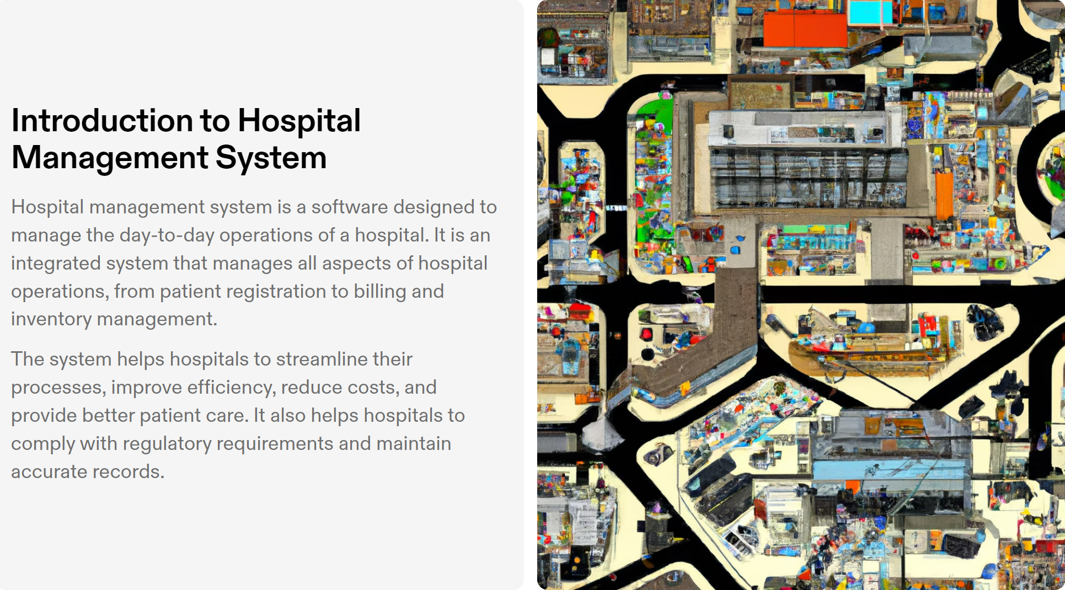
INTRODUCTION

Slide 4
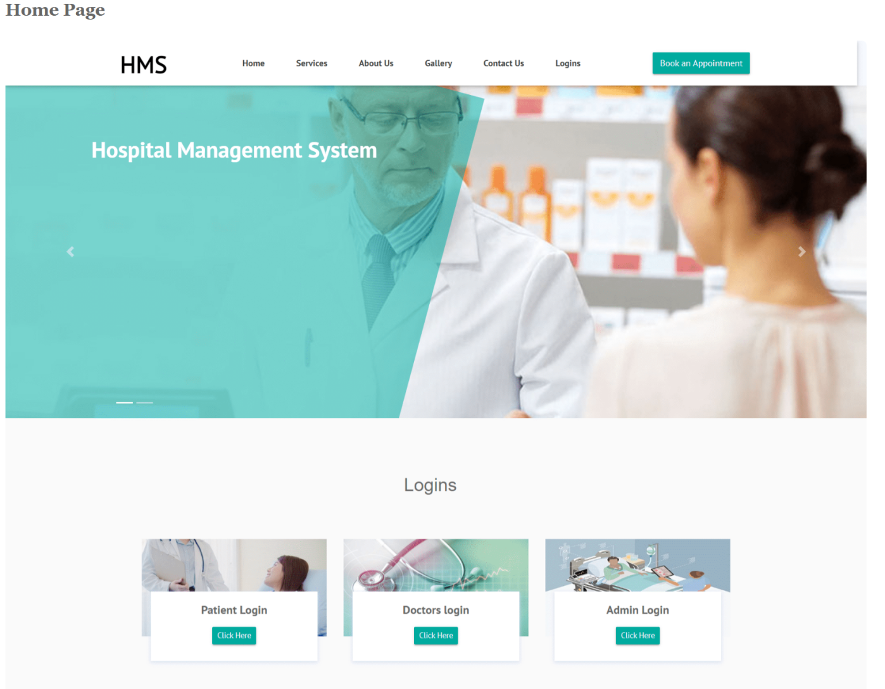
HOME PAGE

Slide 5
The entire project mainly consists of 3 modules
Admin module
User module
Doctor module

Slide 6
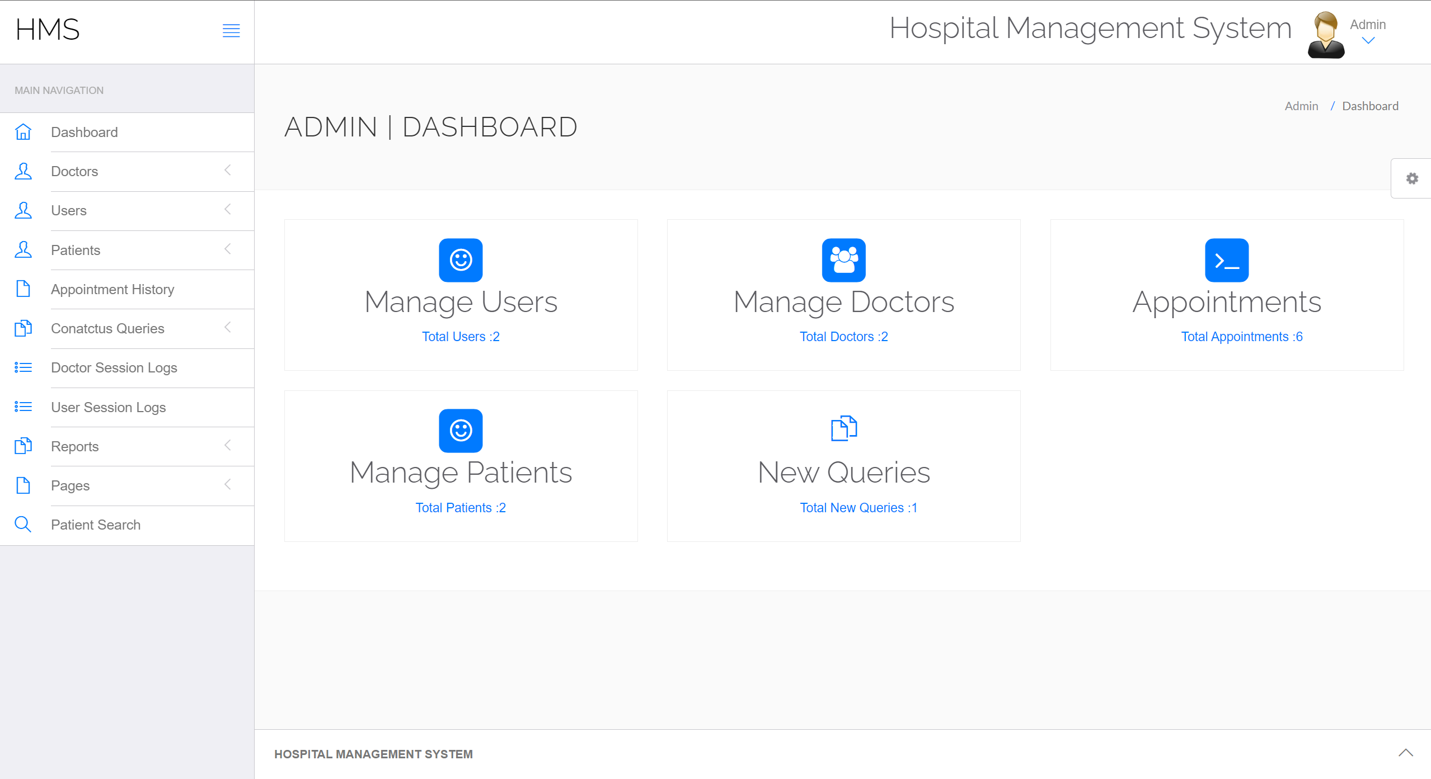
ADMIN MODULE

Slide 7
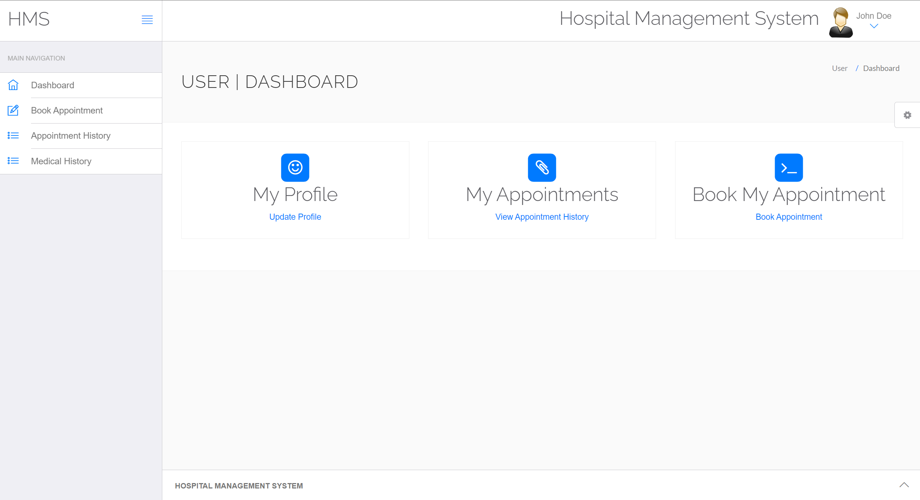
USER MODULE

Slide 8
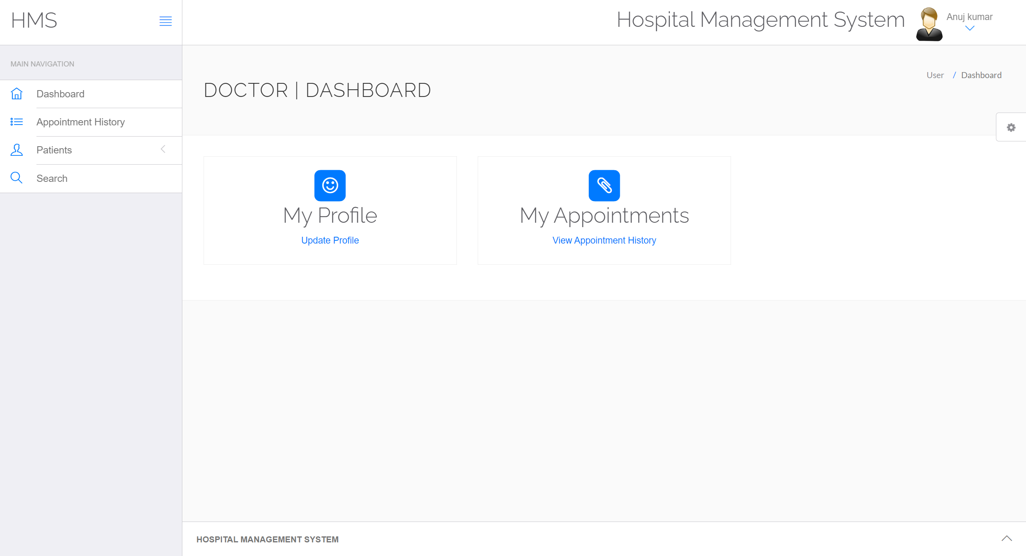
DOCTOR MODULE

Slide 9
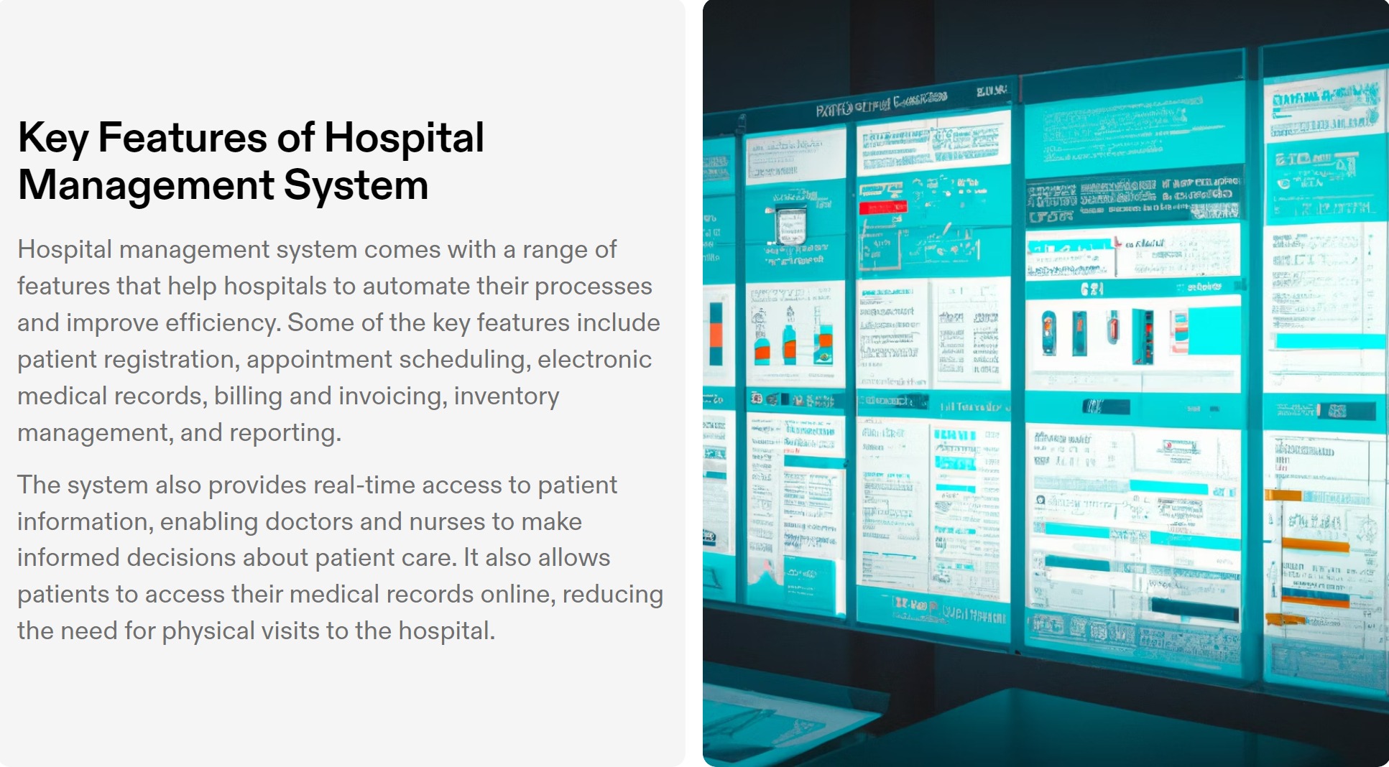
KEY FEATURES

Slide 10
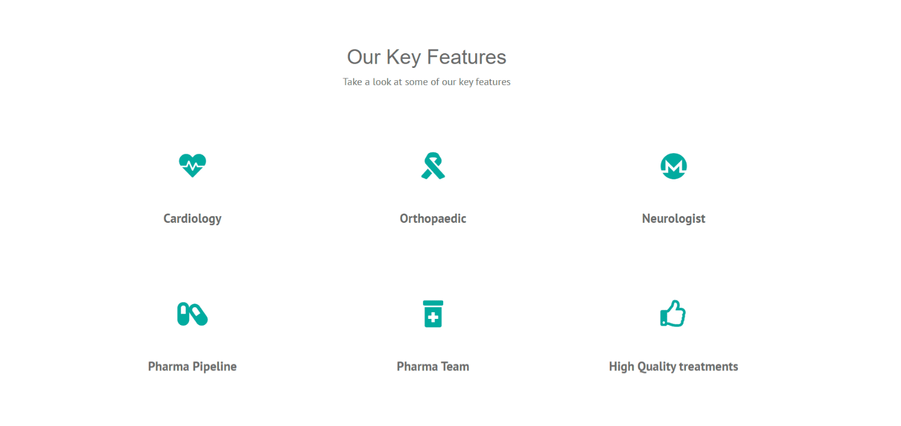

Slide 11
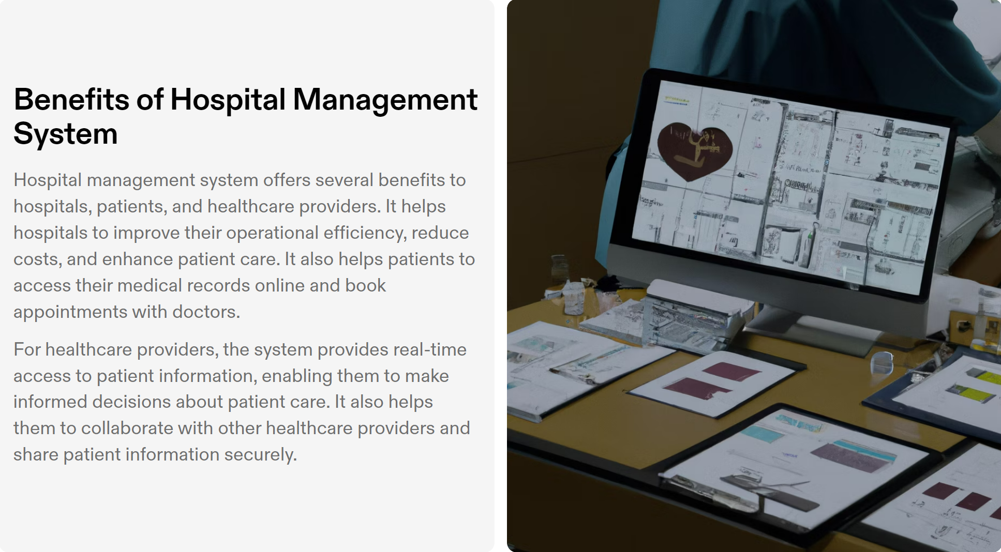
BENEFITS

Slide 12
SOFTWARE USED
XAMPP(Apache Mysql Php)
NOTEPAD++ OR ANY OTHER TEXT EDITOR
CHROME OR ANY OTHER BROWSER

Slide 13
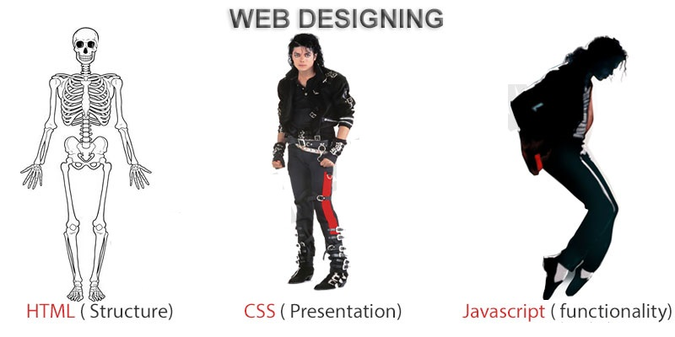
FRONTEND (LANGUAGE USED)
HTML (HYPERTEXT MARKUP LANGUAGE)
CSS (CASCADING STYLE SHEET)
BOOTSTRAP (FRAMEWORK OF CSS AND JS)

Slide 14

BackEnd Technologies Used
PHP(Hypertext Preprocessor)(Server Side Language)
MYSQL(Database)

Slide 15

CHALLENGES

Slide 16
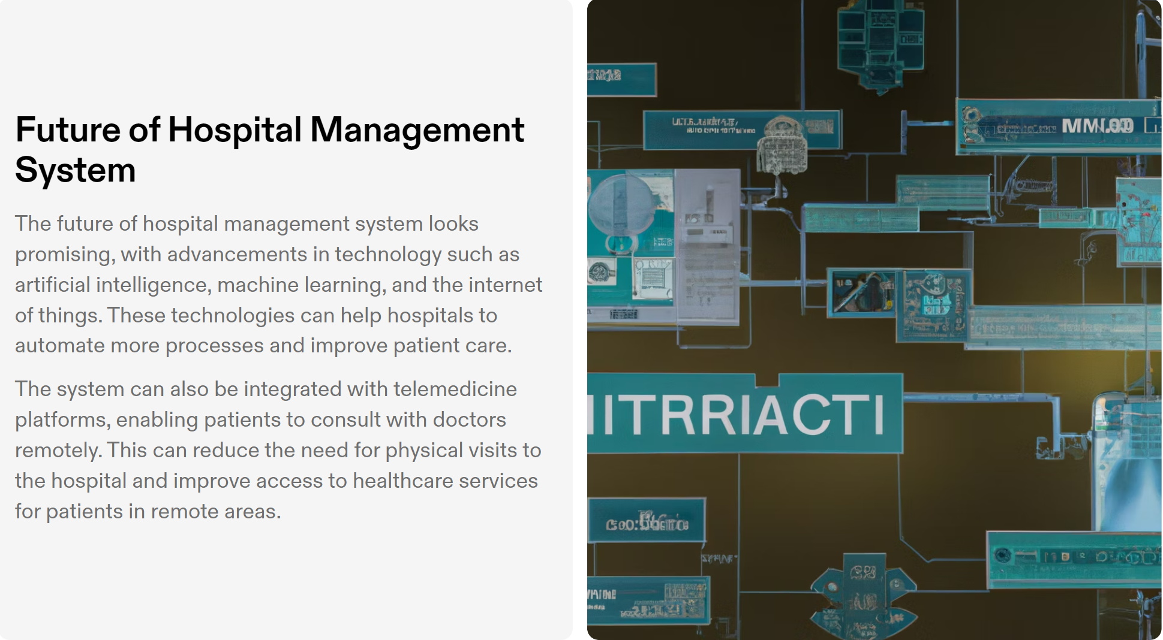
FUTURE

Slide 17
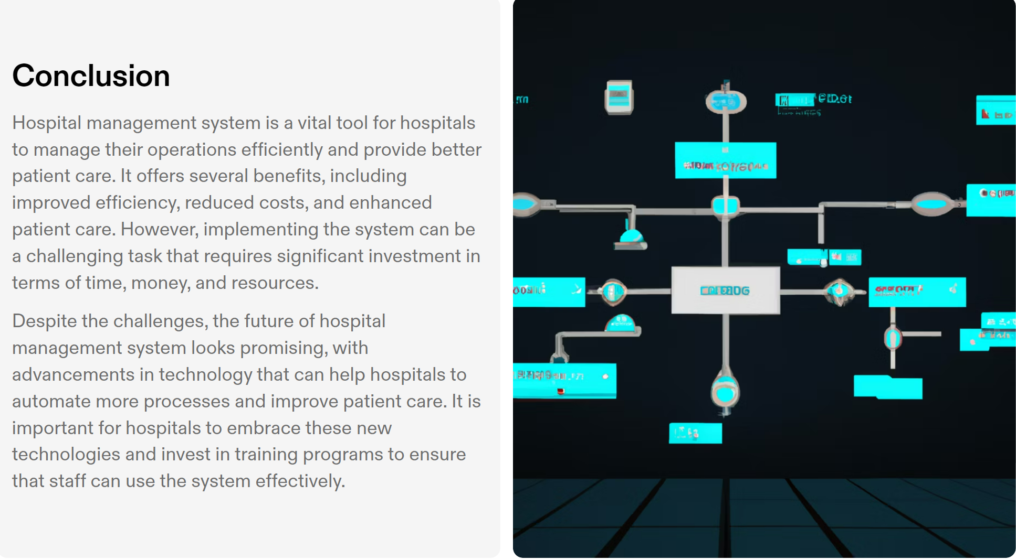
CONCLUSION

Slide 18
THANK YOU

